Slide 1

LEADDESK
The industry-leading platform for call center, inside sales and telemarketing operations.

Slide 2
Who is LeadDesk?
What is LeadDesk?
Why LeadDesk?
How to get started?

Slide 3





LEADDESK COMPANY
Software company helping sales-oriented companies do business on the phone
5
Key product, the LeadDesk software, handles >2.5 million calls and >100.000 deals made on the phone EACH WEEK.
1
2
Founded in 2009 in Helsinki
6
Modular offering that is always provided from the cloud. “Amazing for outbound, OK for inbound”.
Funded by founders and Finnish Technology Agency
7
All development done internally, development team sits in Lappeenranta, Finland.
3
Revenues in 2014 >5m€, business profitable and growth-rate 2x p.a. >500 customers in >20 countries.
8
Local sales & support offices in 6 countries (Finland, Sweden, Norway, Denmark, Germany, Poland), other European markets supported remotely
4

Slide 4
WHAT SETS LEADDESK APPART
WE HELP YOU TO CLOSE MORE BUSINESS
LeadDesk is not another “call center system provider”. We have learned to help companies do business on the phone, both inbound and outbound.
YOUR SOLUTION IS TAILORED FROM MODULES
The most proper solution can be tailored for you. But this is done from well-tested “lego pieces” ensuring speed and reliability. Still provided as SaaS, no projects required.
LEADDESK TAKES END-TO-END RESPONSIBILITY
The software is developed in-house. Required changes are simple to get done. We also provide support & implementation. So no finger-pointing to the “next guy”.

Slide 5



















500+ CUSTOMERS IN 20+ COUNTRIES TRUST LEADDESK

Slide 6
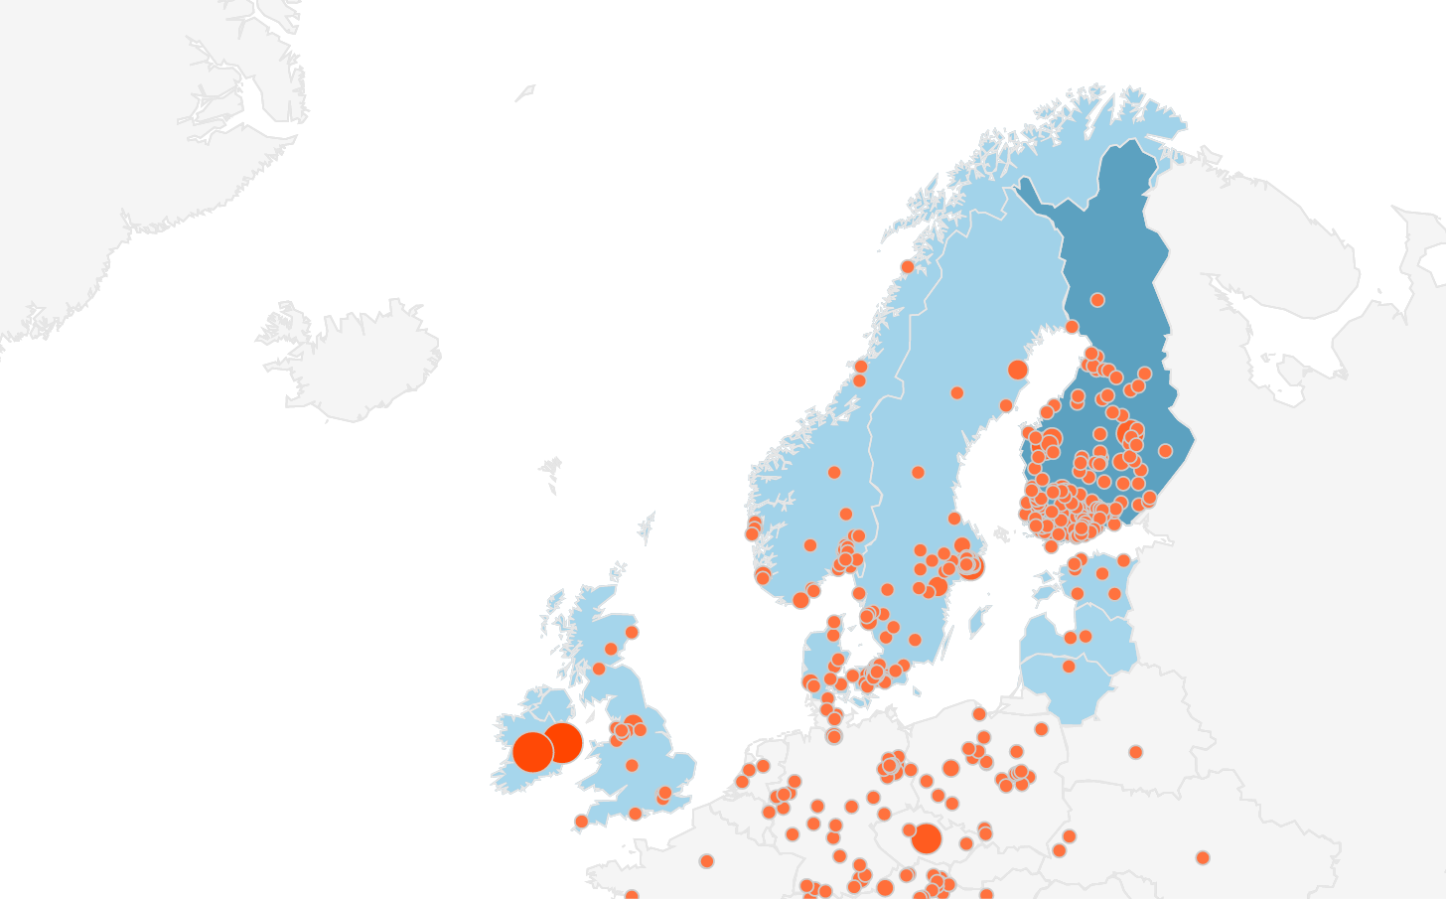
500+ CUSTOMERS IN 20+ COUNTRIES TRUST LEADDESK
NOTE: LeadDesk’s outsourcer customers can easily tap into the network of LeadDesk users!

Slide 7
OUR TYPICAL CUSTOMER INDUSTRIES
Media & Publishing
Software & IT services
Insurance
Telecommunications
Food supplements
PayTV
Energy
Business services
Home improvement services
Investing
Performance marketing
HR/Contracting
Charity & Fundraising
Consumer credit
Others

Slide 8

OUR TYPICAL CUSTOMER ORGANIZATIONS
Lead generation & Inside sales units
Internal & service providers
B2B
Outbound projects
Call center & Telemarketing org’s
Internal & service providers
B2B & B2C
Inbound & Outbound projects
Outsourcers
Product owners working with service providers
B2B & B2C
Outbound projects
Other segments include, e.g., Debt collection & Teleresearch

Slide 9
Who is LeadDesk?
What is LeadDesk?
Why LeadDesk?
How to get started?

Slide 10












KEY FEATURES OF LEADDESK
Cloud-based system
Full agent interface
Smart outbound campaigns
You only need LeadDesk & an Internet connection. No hardware required.
Everything a call center agent needs – from dialing to order-taking to time management.
Designed to manage campaigns, calls & sales – including email and SMS.
Contact database
Flexible operator choice
Reporting and live screen
Use LeadDesk as your CRM for customer acquisition.
Let us be your phone company. Or choose any other operator.
Run off-the-shelf or tailored reports & show real-time data internally and to product owners
Contact intelligence
Telephony options
Dialer modes
LeadDesk is integrated with B2B/B2C data sources & can automatically clean bad data.
Use VoIP, GSM or landline calling – or integrate with any PBX.
Preview calling, progressive calling, predictive calling & more dialer options.
Quality control
Outbound & inbound
API
Listen to call recordings & real time conversations. Track agent productivity.
Make & receive calls. Use IVR. LeadDesk is the only system you need.
Link LeadDesk with your ERP & reporting systems.

Slide 11
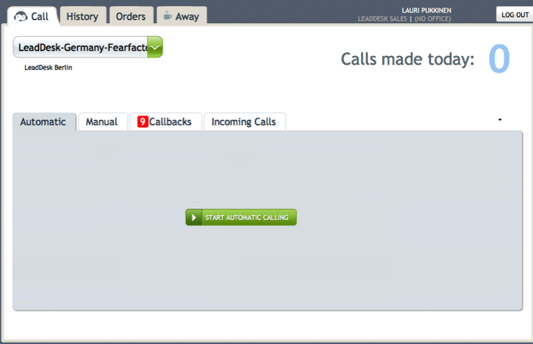
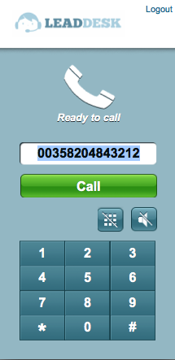
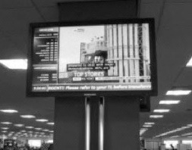
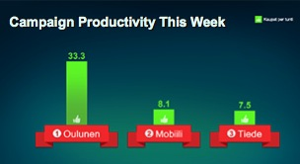
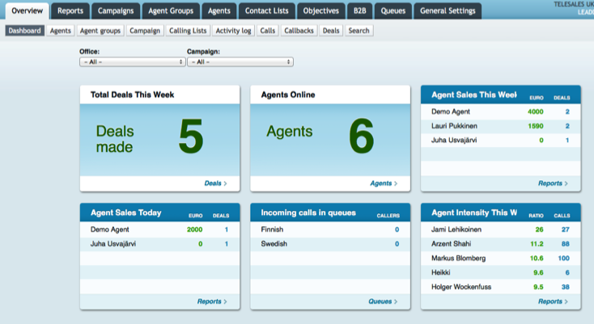
USER ITERFACES FOR DIFFERENT USER GROUPS
Call center agent / sales person
User interface on computer
All-in-one or integrated to 3rd party system
Headsets & GSM
Manager
Access all data and settings with web browser
Can be pushed to 3rd party applications
Team screen
Selected data show to all office
Can get special effects (bell for deal, etc.)

Slide 12
HOW LEADDESK FITS IN AMONG OTHER SOFTWARE
LD
Click-to-call on any CRM
CRM
Effective/automated outreach campaigns on any CRM
CRM
LEADDESK
Cold leads exclusively on LeadDesk, follow-up steps on other CRM
LEADDESK
CRM
LeadDesk runs the whole campaign
LEADDESK

Slide 13
Who is LeadDesk?
What is LeadDesk?
Why LeadDesk?
How to get started?

Slide 14
BENEFITS TO EXPECT FROM LEADDESK SOFTWARE
…
Higher revenues
Flexibility
Less cost
New business opportunities
Link with other systems
Better quality
Control & coordination
Less manual work
Solid reliability

Slide 15
WHY LEADDESK SOFTWARE?
TCO* reduction
Revenue increase
Systematic and efficient customer outreach (through solid basic outbound features)
#1 complete feature set already today (e.g., sms, list handling/database, leaderboards etc.)
Rapid release cycles
Strong track record of reliability (>99.8% avail., no single outage in 3 months)
Flexible system to open (and close) new offices and projects quickly
Support to remote agents (viable telephony solution) & multi-office setup
Easy system for both agents and admin users to learn (quick recruiting & ramp-up)
Savings on phone bill (local carriers)
Same system used by subcontractors and e.g. sales departments (already in use!)
✓
✓
✓
✓
✓
✓
✓
✓
✓
✓
✓
✓
✓
✓
✓
* Total Cost of Ownership

Slide 16
WHY LEADDESK AS YOUR PARTNER?
TCO* reduction
Revenue increase
Focus and R&I investments 100% in call center and inside sales systems (54th release since 2009)
No compromises is reliability & data security (multitenant setup, separate virtualized DBs, 3 server providers, 2 full-time testers, SLL etc.)
Dedication to customer service (practically a 24/7 operation, chat support possibility to admin users etc.)
Company based in Germany (all communication & interfaces in German, local datacenter provider)
Perfect balance of being established and agressively growing/developing LeadDesk
Strong management team
✓
✓
✓
✓
✓
✓
✓
✓
✓
* Total Cost of Ownership

Slide 17
Who is LeadDesk?
What is LeadDesk?
Why LeadDesk?
How to get started?

Slide 18
GETTING LEADDESK IS SIMPLE & SAFE
Bronze
Silver
Gold
50€
/seat/month
100€
/seat/month
150€
/seat/month
No fixed-term contract
Starting from 1 seat
Use any operator
Full money-back guarantee

Slide 19
 | Bronze | Silver | Gold
Price | 50 €/month | 100 €/month | 150 €/month
Features | Phone book Automatic redial Call recording Reporting Call results Agent tracking (incl. work-time tracking) | Bronze and these: Contact database Contact lists Campaign management Product order Call receipt Email and SMS Admin dashboard Admin live listening | Silver and these: Commission management Manuscript Meeting calendar Account-level list mgmt and calling (“B2B”) Conference calls and call forwarding Admin live whisper
Agent interface | Basic | Advanced
Outbound calling | Manual, Click-to-Call | Manual, Click-to-call, Power dial, Semi-automatic, Selective
Inbound/outbound | Both
Operator choice | Any VoIP or GSM operator | Any VoIP or GSM operator | Any VoIP or GSM operator
SMS | Refer to price list | 100 agent/month included | 300 agent/month included
User support | Refer to price list | Refer to price list | 10 hours/month by tel. included
Recording storage | 3 months | 6 months | 24 months
Web service API calls | Unlimited | Unlimited | Unlimited
Extended security | n/a | SSL | SLL, IP restrtiction
SLA | n/a | 99.98% | 99.98%

Slide 20
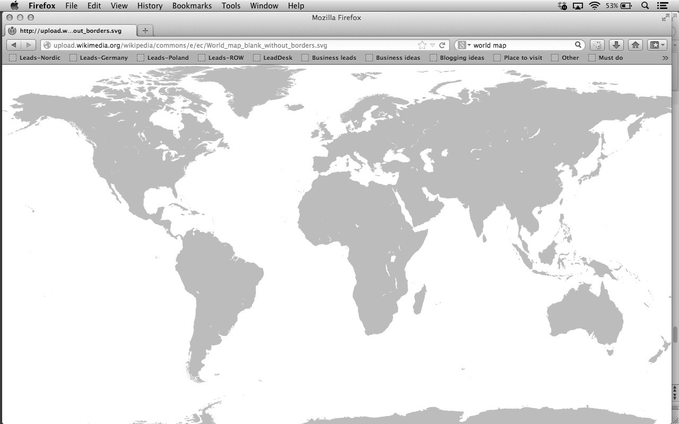
WE PROVIDE YOU WITH ACCESS TO 24/7 SUPPORT
LeadDesk Support Centers
Web site Email
support.leaddesk.com support@leaddesk.com
Global
LeadDesk GmbH Pappelallee 78/79, Berlin Hotline: +358 942891826 (Mon-Sat, 8am – 8pm CET)
Germany Poland
LeadDesk GmbH LeadDesk branch office Poland Pappelallee 78/79 ul. Smulikowskiego 1/3 Berlin , Germany Warsaw, Poland Hotline: +49 3030806357 Hotline: +48 223073921
Denmark/Sweden/Norway Finland & Baltic countries
LeadDesk AB LeadDesk Oy Hornsgatan 15 Hämeentie 19A Stockholm, Sweden Helsinki, Finland Hotline: +46 852503941 Hotline: +358 942891826
Sales
First point of contact
Mr. Lauri Pukkinen +49 151 70226715 lauri.pukkinen@leaddesk.com

Slide 21
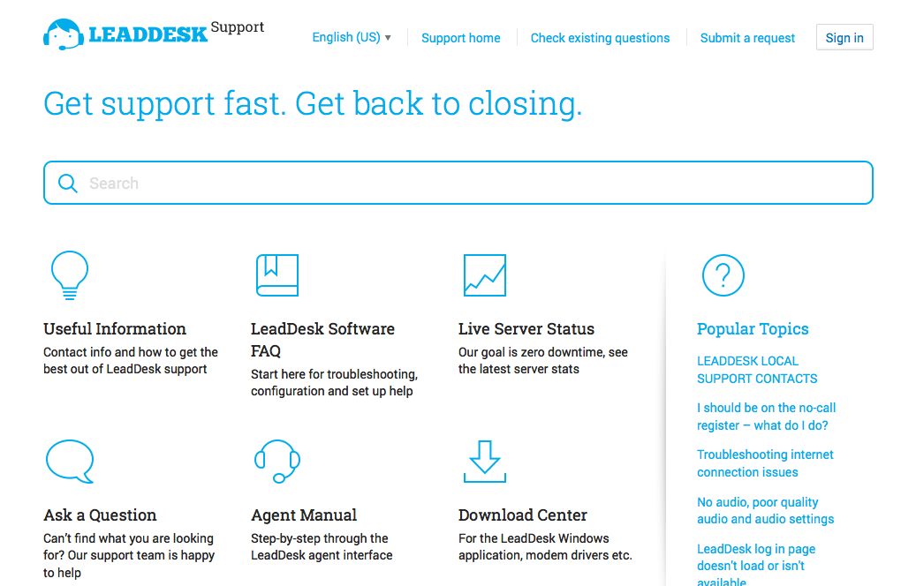
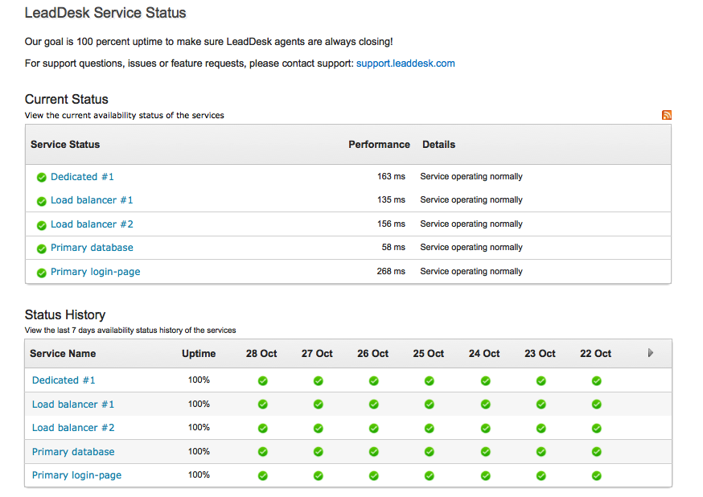
WE ARE FULLY TRANSPARENT – EXAMPLES FROM USER RESOURCES & UPTIME TRACKING
support.leaddesk.com
status.leaddesk.com

Slide 22
Data Analysis.
The most important thing in data analysis, we can get measurements and predictions.

